Slide 1
Logistic Regression Classification Algorithm
TechCoreEasy
Speaker : Mahavir Teraiya

Slide 2
Agenda:
TechCoreEasy
Quick Brush Up Of Few Basic Concept.
Difference in Linear Regression & Logistic Regression
What is Logistic Regression ?
How Logistic Regression works ?
Important Assumptions in Logistic Regression.
Pros/Cons of Logistic Regression.
Applications.
Quick Recap

Slide 3
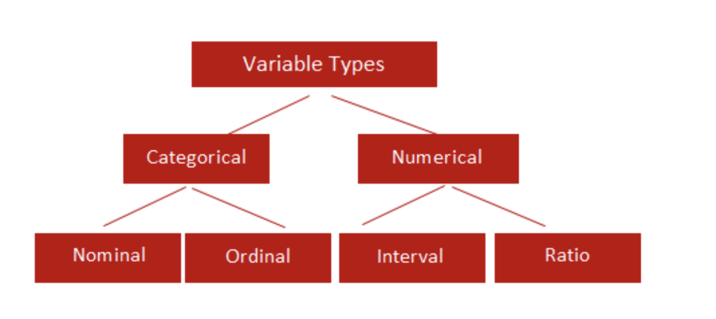
Quick Brush Up Of Few Basic Concept.

Slide 4
Difference in Linear Regression & Logistic Regression.
in very simple terms, Logistic Regression is about predicting a label and Linear Regression is about predicting a quantity.

Slide 5

What is Logistic Regression ?
Instead of predicting the class of a record we want to predict the probability of the class given the record
The problem of predicting continuous values is called regression problem
General approach: find a continuous function that models the continuous points.

Slide 6

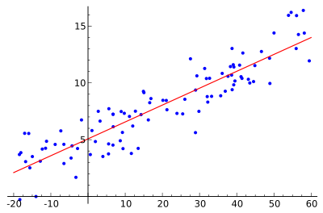

Example: Linear regression
Given a dataset of the form $\left\{{(x}_{1},y_{1}) ,…,{(x}_{n},y_{n})\right\}$
find a linear function that given the vector $x_{i}$ predicts the $y_{i}$ value as $y_{i}^{′}=w^{T}x_{i}$
Find a vector of weights $w$ that minimizes the sum of square errors
$\sum_{i}{{\left(y_{i}^{′}− y_{i}\right)}^{2}}$
Several techniques for solving the problem.

Slide 7
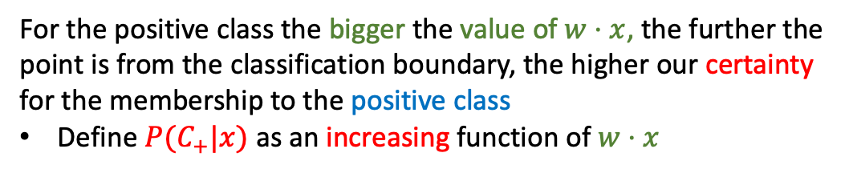



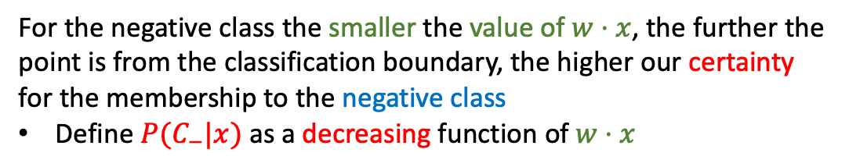
Classification via regression
$$w⋅x>0$$
Assume a linear classification boundary
$$w⋅x=0$$
For the positive class the bigger the value of $w⋅x$, the further the point is from the classification boundary, the higher our certainty for the membership to the positive class
Define $P(C_{+}|x)$ as an increasing function of $w⋅x$
For the negative class the smaller the value of $w⋅x$, the further the point is from the classification boundary, the higher our certainty for the membership to the negative class
Define $P(C_{−}|x)$ as a decreasing function of $w⋅x$
$$w⋅x<0$$

Slide 8
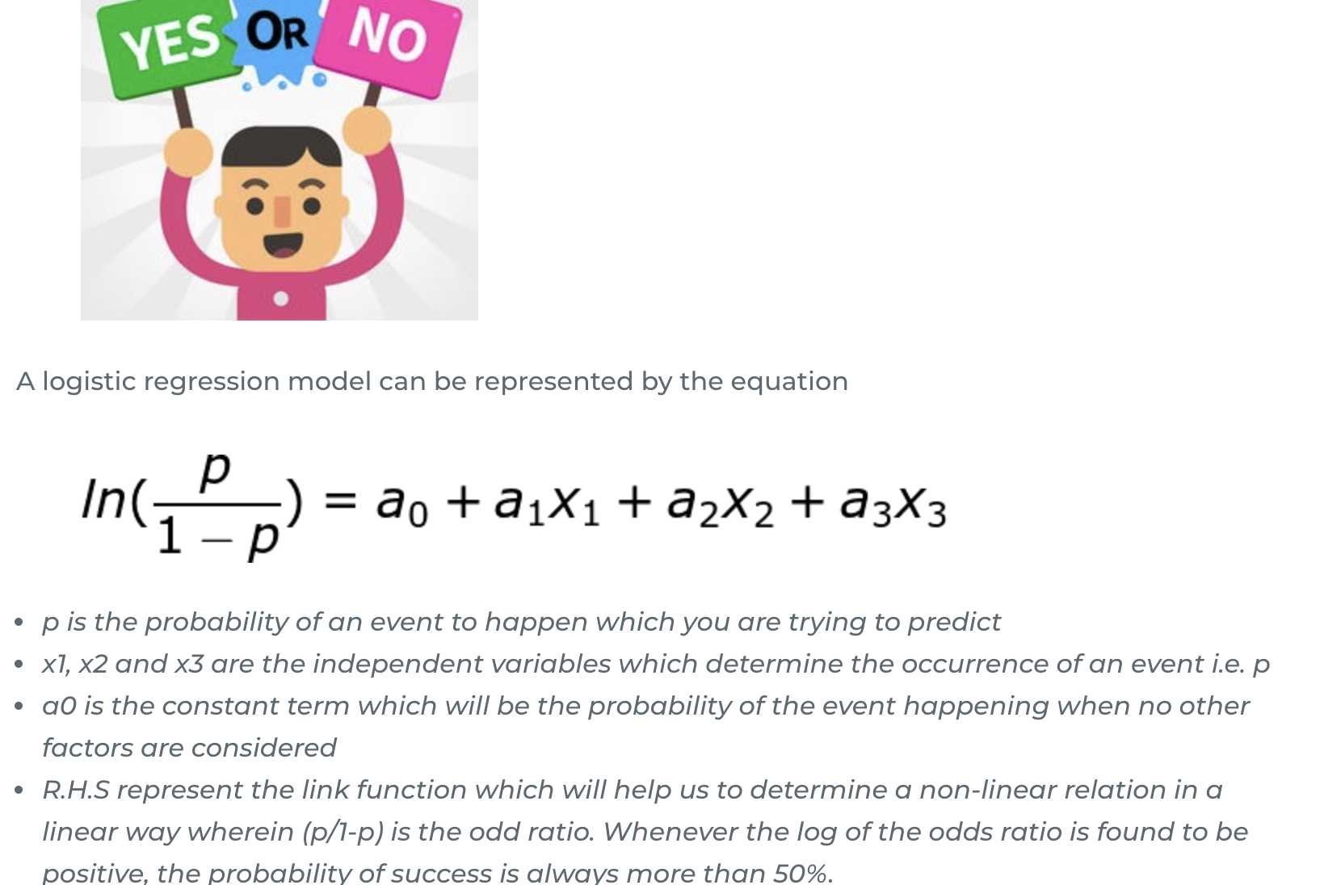
What is Logistic Regression ?

Slide 9
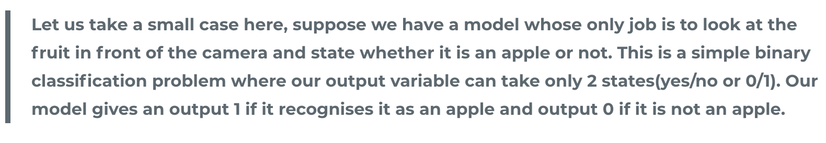
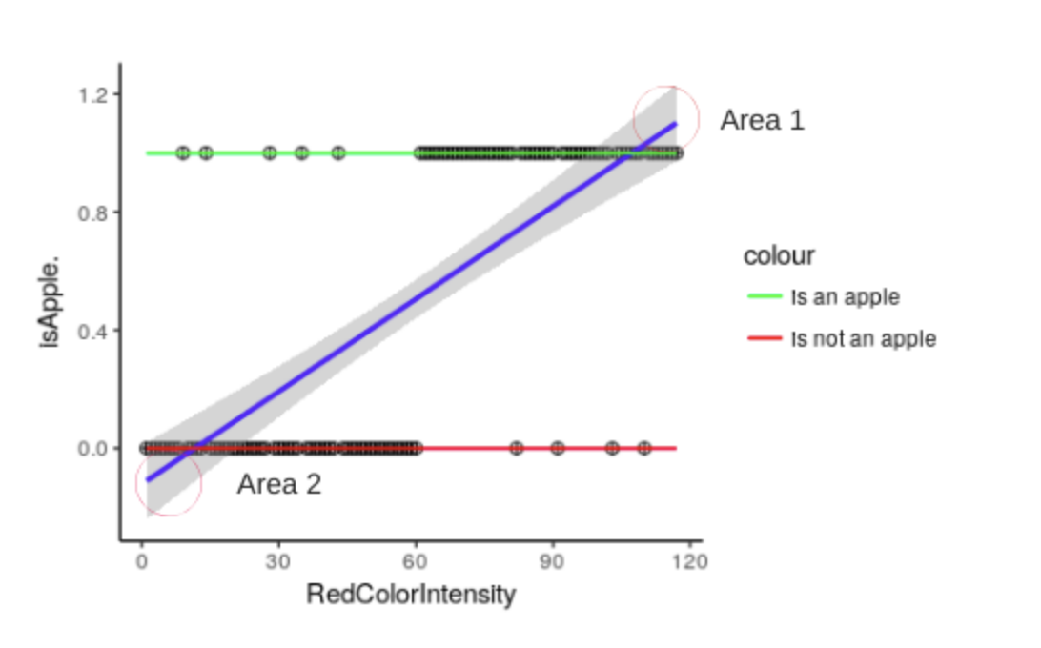
How Logistic Regression works ?

Slide 10
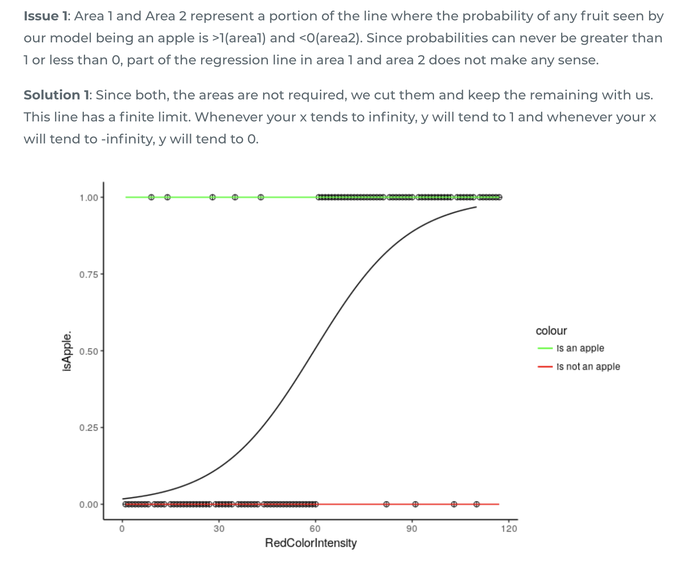

Slide 11
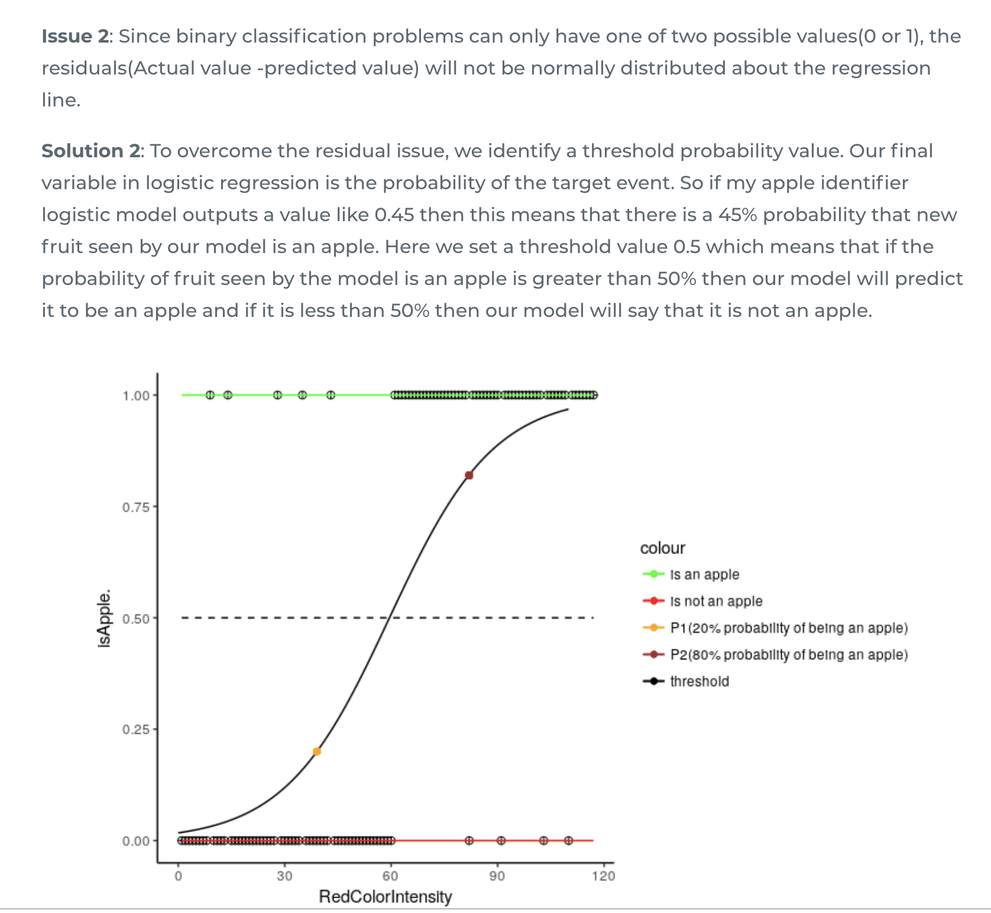

Slide 12
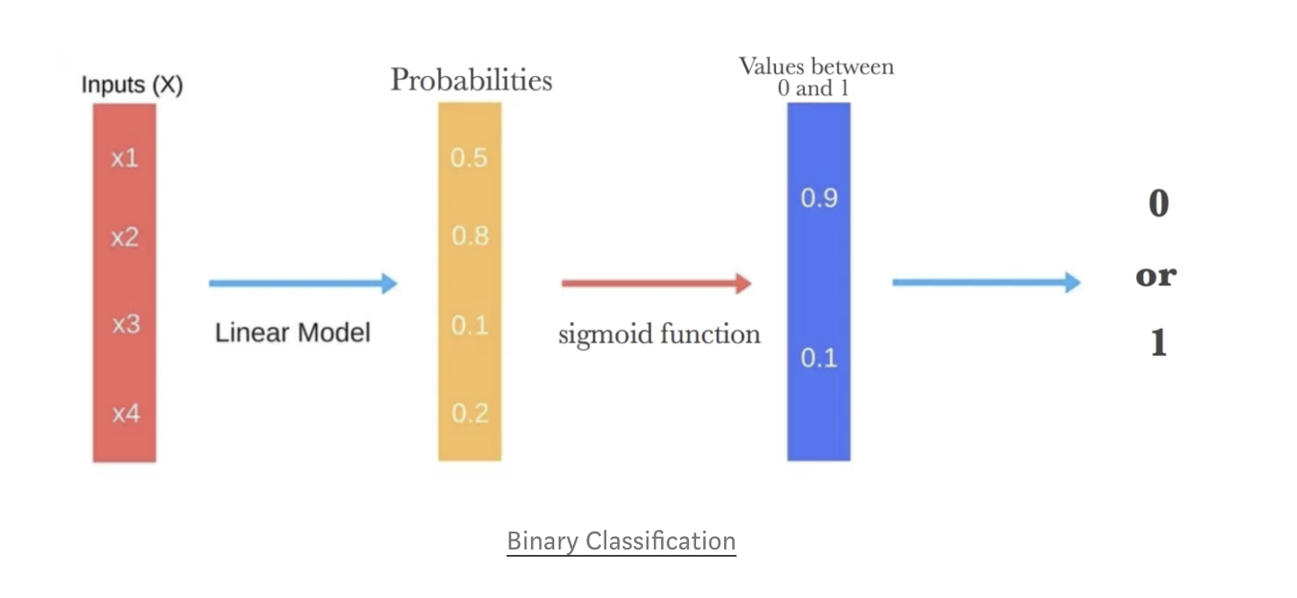
Sigmoid function

Slide 13

Important Assumptions in Logistic Regression.
Logistic regression requires the dependent variable to be categorical
Logistic regression requires there to be little or no multicollinearity among the independent variables. This means that the independent variables should not be too highly correlated with each other.
There should be a linear relationship between the link function (log(p/(1-p))and independent variables in the logit model.

Slide 14
TechCoreEasy
Pros:
Produces a probability estimate for the class membership which is often very useful.
The weights can be useful for understanding the feature importance.
Works for relatively large datasets
Fast to apply.

Slide 15
TechCoreEasy
Cons:
Doesn't perform well when feature space is too large.
Doesn't handle large number of categorical features/variables well.
Relies on transformations for non-linear features.
Relies on entire data [ Not a very serious drawback I'd say]

Slide 16
TechCoreEasy
Applications :
Image Segmentation and Categorization.
Geographic Image Processing.
Handwriting recognition.
Healthcare : Analysing a group of over million people for myocardial infarction within a period of 10 years is an application area of logistic regression.
Prediction whether a person is depressed or not based on bag of words from the corpus seems to be conveniently solvable using logistic regression.

Slide 17
TechCoreEasy
Quick Recap

Slide 18

TechCoreEasy

